Slide 1


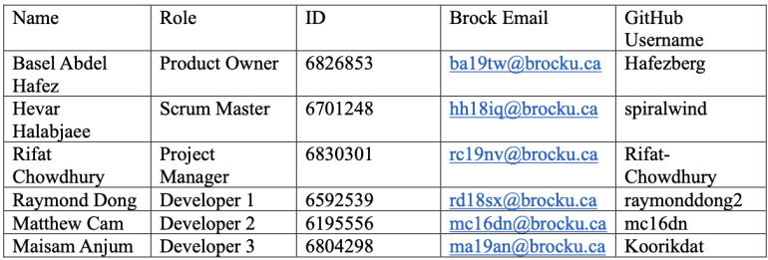



COSC 4P02
Social Media Post Generator

Slide 2
Why a Reddit Video Generator?
Reddit video posts have been on the uptake for years now.
This program is a proof of concept.
Feasible to complete within the timeframe.
Our skills aligned with creating this program.
Notes:
Point 1: Point out the popularity of these videos in TikTok and YouTube Shorts.
Point 2: Point out that, with the proper time and budget, this program could make videos that are indistringuishable from currently viral videos. It can also be applied to other forms of video generation using the same foundation.
Point 3: Bring up that we budgeted our time expecting to have to cut some features out. Though, we were sure to make the foundation of the program first, so that cut content won't waste too much time.
Point 4: When we were pitching ideas, we were sure to incorporate everyone's skillset. While I brought up this idea and elaborated on what it would result in, we would not have taken it on if we had no experience in this subgenre of programming.

Slide 3
Sprint 1
Focused on the foundation of the program.
Brainstormed ideas for the backlog during this period.
By the end, we successfully interfaced with the API after much trouble.
Successfully implemented the Reddit post grabber, though execution time was an issue.

Slide 4
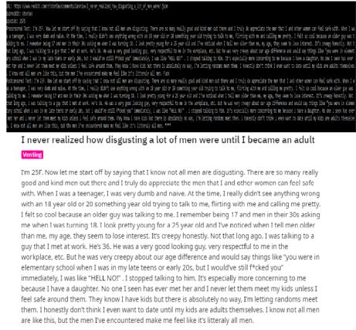
Sprint 1's Execution
As seen in the picture, this grabber was the fruit of our efforts after the first Sprint.

Slide 5
Sprint 1's Issues and Development
Decided to start with grabbing reddit.
Reddit doesn’t allow to grab a lot of Reddit’s posts at once.
Used different API.
Censorship wasn’t censoring everything.

Slide 6
Sprint 2
Focused on the TTS module and polishing the censorship algorithm.
Built the methods needed for Sprint 3's video generation. Namely the video generation module.

Slide 7
Sprint 2's Issues and Development
Text was not come out very cleanly.
Text was not spacing well.
Tried to see if we could use a different voice module.
When producing video for some reddit the array went out of bounds.

Slide 8
Sprint 3
Successfully generated a completed video.
Metric collection algorithm created, but untested due to no upload algorithm.
Created the foundation of the uploading algorithm.
Notes:
Elaborate on Point 2
Point 3: YouTube's privacy policy prohibited us from testing the algorithm on videos that weren't ours.

Slide 9

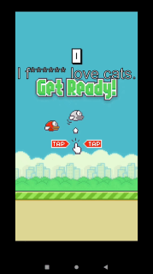
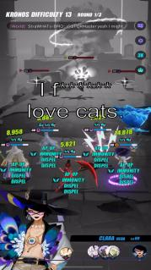



Sprint 3's Execution

Slide 10
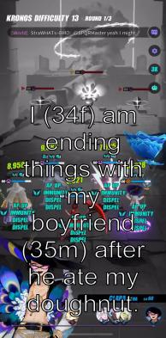
Sprint 3's Issues and Development
Find videos templates to use.
Decided how to use templates.
Merging takes a long time.
Import issues with MoviePy.

Slide 11
Sprint 4
Almost entirely dedicated to GUI development.
Issue with long videos was fixed.
Subtitles were massively improved.

Slide 12
Sprint 4's Issues and Development
Time constraints.
Trying to obtained user data without authentication.
Testing issues with other members.
Loading bar into GUI.

